Slide 1
I AM A PILOT
Pilot International New Member Guide

Slide 2
As a member of Pilot International, you have been embraced not only by your local Pilot Club but by the International organization as well. Pilot International strives to provide our members with excellent service including constant communication and an ever-evolving collection of new resources and ideas to help you and your Pilot Club thrive and succeed in each of your endeavors.
In order to ensure that you receive the latest news from Pilot International and your personal copy of the Pilot Log, please be sure to keep your financial obligations and your contact information - both your physical and preferred email addresses - up to date with Pilot International Headquarters. If your information should change at any time or if you need assistance regarding your membership or your Pilot Club, please contact Pilot International Headquarters. As you are called to serve your community, Pilot International Headquarters is here to serve YOU.
Enhance your Pilot membership experience by visiting the Pilot International Website. The PI Website offers a wealth of knowledge and news about all aspects of Pilot International and is where you will find valuable resources such as the Pilot Club Manual and other important club documentation. The PI Website is updated on a frequent basis, so be an engaged and informed new member - visit www.pilotinternational.org and visit often!

Slide 3
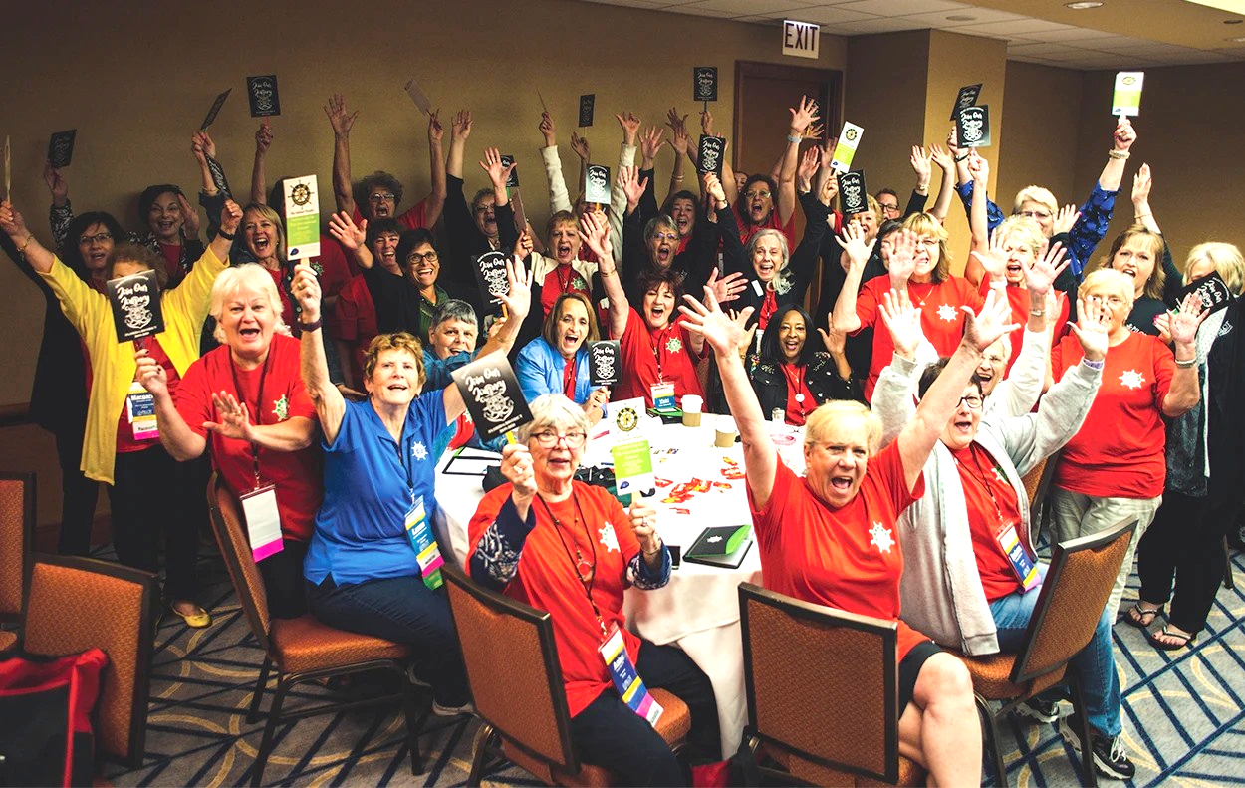
Welcome to Pilot International!
You have just joined an exceptional organization of unique individuals from all around the globe. Our diverse membership of men and women of all ages and all walks of life whose hearts - just like yours - are led to serve. Since 1921, Pilots have upheld the principles of Friendship & Service by joyfully meeting the needs of individuals and communities the world over. In joining Pilot International, you have made the choice to Do More, Care More and Be More for YOUR community! Congratulations! Today...YOU ARE A PILOT!

Slide 4
What is Pilot International?
Pilot International is a community-based volunteer service organization founded in 1921 in Macon, GA, on the guiding principles of “Friendship and Service.” From its very beginnings, Pilot International and its clubs have been dedicated to spreading the spirit of volunteerism throughout the world.
Today, Pilot is a proud and active member of the Service Club Leaders Conference along with organizations such as Lions Club International, the General Federation of Women’s Clubs, Rotary International, Kiwanis International and others.
Originally designed as a volunteer service organization for business and professional women, Pilot International has since expanded to include men and women from around the globe and in all walks of life. Since its founding In 1921, thousands of members and many clubs across the United States and Internationally have helped Pilot International proudly serve the varying needs of communities around the world.
In 1952, Pilot began to recruit youth volunteers through the establishment of Anchor Club, a volunteer service organization for young people. Today, there are Anchors serving worldwide.
Each year, Anchor Club graduates go on to be leaders and service-minded citizens on college campuses and in their respective communities. Today’s Anchors are tomorrow’s leaders.
Pilot International is also the proud parent organization of Compass Club, a blossoming organization for young adults seeking an opportunity and an outlet to serve their local needs after high school.
Pilots proudly support the Pilot International Founders Fund, which exists to further the organization’s educational and humanitarian activities through the disbursement of grants and scholarships to support cause-related programs and activities.

Slide 5
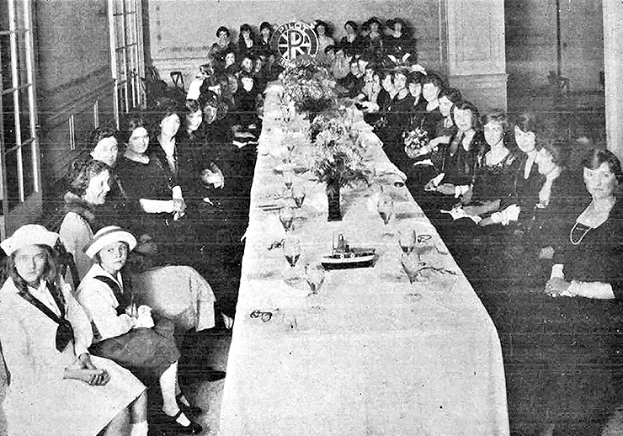
How Pilot International began
ONE WOMAN’S VISION
In 1921, the harrowing memories of WWI had started to fade. The country’s morale was on the mend. The nation felt that the worst was behind them, and a positive new energy had swept across the land. Freedom and Independence had prevailed.
Women, thanks to the success of the women’s suffrage movement and the adoption of the 19th Amendment, had been empowered with a newfound sense of purpose as well. Having recently voted in her first national election, one young woman in particular was looking to do even more.
The early 1900’s had given rise to a new kind of citizen. Prosperous businessmen looking to increase their sphere of influence had started to come together to form “service clubs,” groups dedicated to the betterment of their communities which offered the opportunity not only to serve but also to foster civic leadership and form important and lasting ties. Rotary International, the world’s first service club, was originally organized in 1905 and by 1921 had chartered clubs on six continents. 1917 saw the birth of the first Lions Club which, by 1920, had chartered clubs across the US and even into Canada. One of those Lions in Macon, GA was the employer of a young Elizabeth Leonard.
Inspired by the success of the rise of the men’s service clubs around her, Miss Leonard believed that the same opportunity should be afforded to women who could no doubt be as successful in their efforts, if not more so. With help and guidance from Rotarians and Lions alike, Elizabeth Leonard and six of her friends met on September 7, 1921, and the vision of Pilot was born.
Just as she had envisioned, Pilot immediately began to grow. Through the decades the organization she and her visionary friends founded upon the principles of “Friendship and Service” would spread that spirit across two oceans and bring countless acts of grace to those in need.
Pilot Principles: Friendship and Service Motto: “True Course Ever”
Colors: Green (life and vigor) and Gold (sincerity of purpose)
Emblem: A riverboat pilot’s wheel with eight spokes

Slide 6
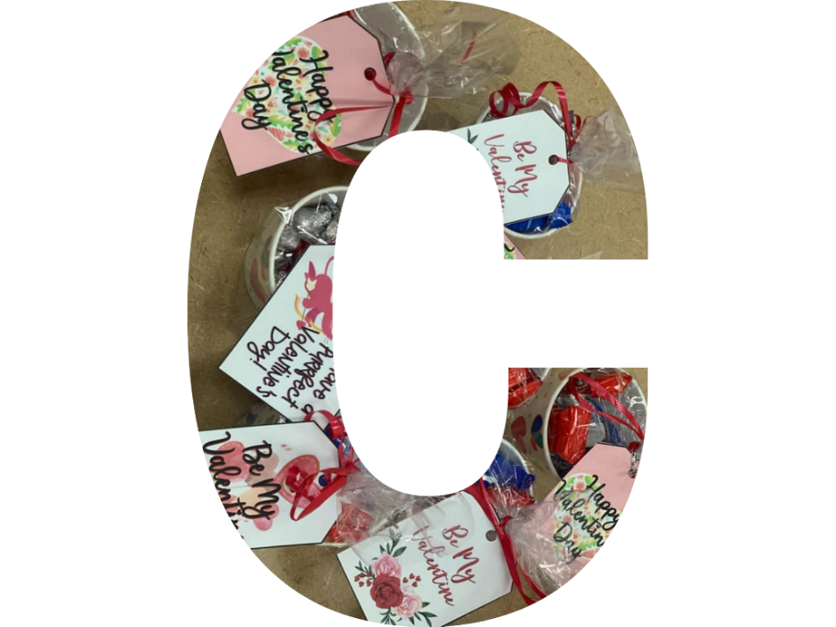
What defines Pilot
Since 1921, Pilot International and its club members serve varying needs of communities around the world.
Although these needs may change over time, Pilot stands ready to meet the challenges and service demands of TODAY.
Today’s Pilots carry out our mission and our call to “Do More. Care More and Be More,” by providing both hands-on and financial support for a diverse family of local, national and global initiatives is in keeping with our three main causes, The “ABC’s” of Pilot:
Advocating Leadership & Service in Youth & Young Adults
Brain Safety and Health
Caring and Supporting Families in Times of Need
The Mission of Pilot International is to influence positive change in communities throughout the world. To Do This, We come together in friendship and service focusing on encouraging brain safety and health and supporting those that care for others.

Slide 7
Anchor Clubs
Ruby Newhall, President of Pilot International in 1949, first envisioned Anchor Clubs - Pilot’s youth service organization arm. Her vision became a reality in 1952 when the first Anchor Club was chartered in Macon, Georgia.
Using their own name as a guide, Anchor Club’s professionally developed curriculum, strategic national partnerships and unique programs such as the annual Anchor Leadership Summit strive to instill six specific, valuable qualities and characteristics in today’s young people, enabling them to DO MORE, CARE MORE and BE MORE everyday.
Altruism – Noble Purpose – Citizenship – Honor – Open-Minded - Responsible
Anchor Clubs are sponsored by Pilot Clubs or Pilot individuals and have Advisors that are either Pilots or a faculty/staff member of their school. Pilot and Anchor relationships are very special, and the benefits are immeasurable. If you know of a school or community that would benefit from an Anchor Club, talk to headquarters to get one started!
www.anchorclubintl.org

Slide 8
Compass Clubs
Compass International is the Young Professionals division of Pilot International that began as an International project of the 1967 Convention.
Compass is a community-based service organization for ages 18-26 in the United States (18-28 in Japan). It is an opportunity to participate in unique community service projects, develop leadership and networking skills, and advance personal and professional goals while being mentored by Pilots and Pilot Clubs.
Compass International joins Pilot International’s commitment to building an impactful and sustainable organization into the future by encompassing the same ideals of Pilot Clubs.
www.compassclubintl.org

Slide 9
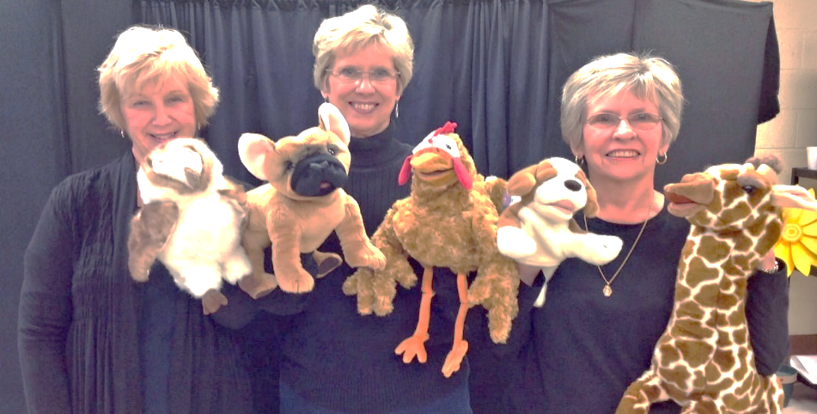
Brain Safety & Health
Since 1992, Pilot International has proudly worked in various aspects of brain-related service. In 2013, Pilot formally narrowed this service focus to Encouraging Brain Safety & Health as the majority of our clubs’ work centers in this area.
Grass-roots, local safety-related initiatives are at the heart of Pilot International’s Brain Safety & Fitness service mission and are championed by Pilots and Anchors worldwide.
Pilot Clubs participate in their community’s local safety fairs and often host bike rodeos where club members have the opportunity to present BrainMinders™ and discuss the importance of brain safety with participating children. Some clubs also present each attendee with a free, new bike helmet, often provided through matching grant funds from the Pilot International Founders Fund or through donations or grants from major corporations.
Pilot International is proud to work with Safe Kids Worldwide, a global organization dedicated to preventing injuries in children, the number one killer of kids in the United States. Pilot International and Safe Kids Worldwide share a common mission: to educate children about safety, promote awareness about injury prevention and provide support for those who have suffered from traumatic injury or loss due to the same. Pilot and Anchor Clubs support the efforts of local Safe Kids Coalitions by participating in Safe Kids initiatives such as National Safe Kids Day, Safe Kids’ distracted pedestrian campaign and other injury prevention and education endeavors.
To further Pilot’s efforts to educate young people about the need for brain-safe practices, Pilot International also supports BrainMinders™, Pilot’s signature family of brain-safety educational programs. Many clubs perform the BrainMinders™ Buddies skits for local elementary-aged students, and the BrainMinders™ “Be Mindful” campaign offers Anchors an opportunity to model thoughtful behavior and encourage personal responsibility within their own schools. The “What Were You Thinking?” BrainMinders™ program educates middle and high-school students about the need for brain-safe practices in areas of specific interest to them such as team sports, biking, skateboarding, texting and driving, etc. - and the consequences that can occur if they don’t.

Slide 10
Supporting Those Who Care for Others
Pilot International and its members are called to CARE MORE. At its core, Pilot International is an organization that CARES. Pilot International is also proud of our multi-generational membership and our dedication to Friendship and Service. In essence, Pilot is a family, and we celebrate families. We are a family that cares for each other, for our communities and for our world.
International Care & Kindness Week - Thanks to the efforts of Pilots everywhere, the second week in November has been named International Care & Kindness Week. International Care & Kindness Week was created to bring awareness to how simple acts can change a day, a life or the world by simply showing someone you care. During this special week, Pilots engage in numerous activities to emphasize and encourage kindness, caring and general goodwill to all! From granting full “Pick Me Ups” experiences or giving “Little Pick Me Ups” to strangers, family and friends to encouraging families (including their own!) to “Get Real!” and put their devices away at mealtimes, Pilots everywhere help spread the news about what it means to really care.
Pick Me Ups - Kind Acts for Those Who Care Introduced in 2013, the “Pick Me Ups - Kind Acts for Those Who Care” program is Pilot’s second signature service initiative. 65.7 million Americans – young and old - devote their time and resources to caring for loved ones at home. Through the “Pick Me Ups” initiative, Pilot International plays a powerful role in encouraging and strengthening these remarkable Family Caregivers. Pilot Clubs work directly with local agencies to identify deserving Family Caregiver candidates and then grant the specific “Pick Me Up” experience chosen by the recipient. The “Pick Me Ups” initiative exists to give Family Caregivers a little something back, a little “Pick Me Up” meant simply to brighten their day, and to remind them that somewhere, someone cares – for them.
TBI Camps - Many Pilot Clubs around the country work with The Brain Injury Association of America to support and sustain several exemplary camps for individuals with traumatic brain injuries (TBI). These outstanding facilities not only provide a positive experience for the campers but also provide an opportunity for much-needed rest for their caregivers. Pilot International is proud of the amazing work being done by our local clubs to improve the quality of life for these individuals and their families.
Pilot International is a proud supporter of Project Lifesaver which aids Family Caregivers by providing timely response to save lives and reduce potential injury for adults and children who wander due to Alzheimer’s, autism, and other related conditions or disorders.

Slide 11
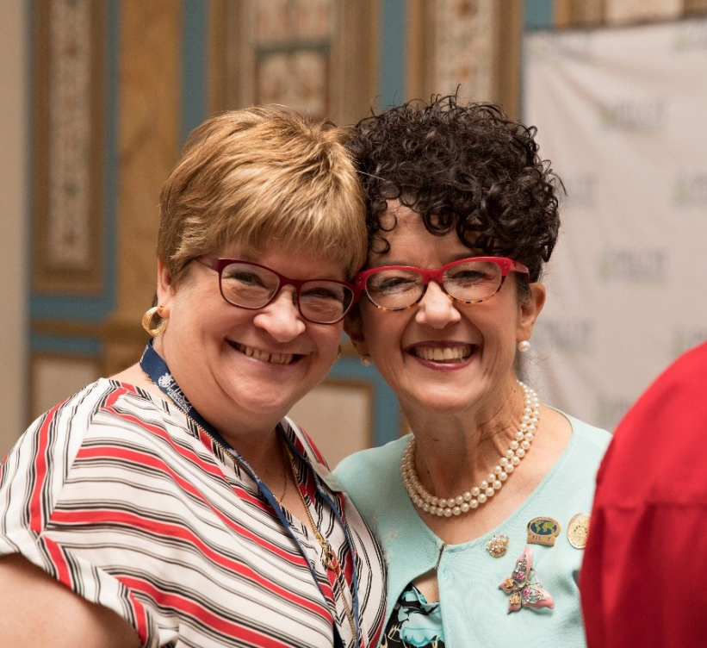
I Am a Pilot ~
Now What Do I Do?
Now that you are a Pilot, it’s your turn to take the wheel.
As a member of Pilot International, you are charged to become a leader in your community, to personally recognize the needs of those around you and to raise your hand to serve. Your Pilot Club exists to provide its members with the opportunity to heed that call and to come together in friendship to make your world a better place.
Every Pilot is different. Every Pilot Club is different, but we are all united in the spirit of Friendship and Service upon which Pilot was founded.
As a Pilot, you have the unique ability and great desire to dig in, to commit to something greater than yourself, to plant that seed of Friendship and Service in your community, to nurture it and to watch it grow.
That spirit of volunteerism that blooms within you is a beautiful thing. Now that YOU ARE A PILOT, you have the means and you have the team to help you realize its full potential. Together with your Pilot Club friends, you can and will Do More, Care More and Be More for your world every day.
The best way to find yourself is to lose yourself in the service of others.
~Mahatma Ghandi

Slide 12
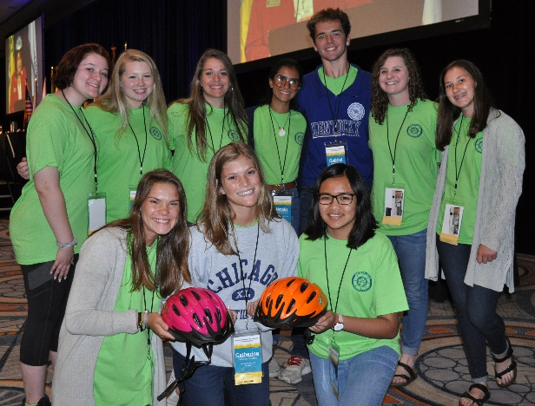
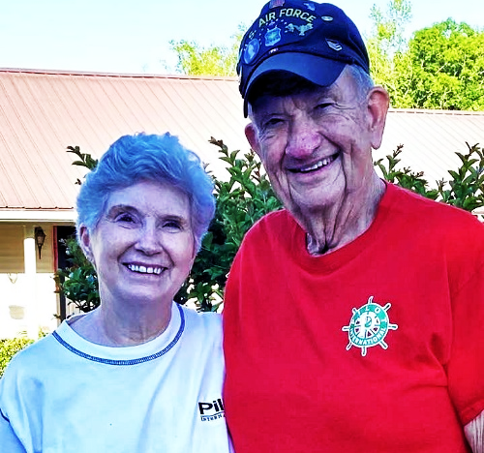
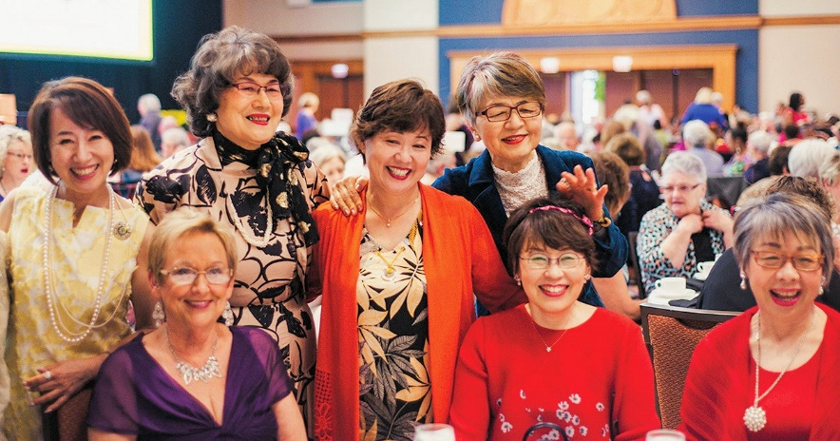
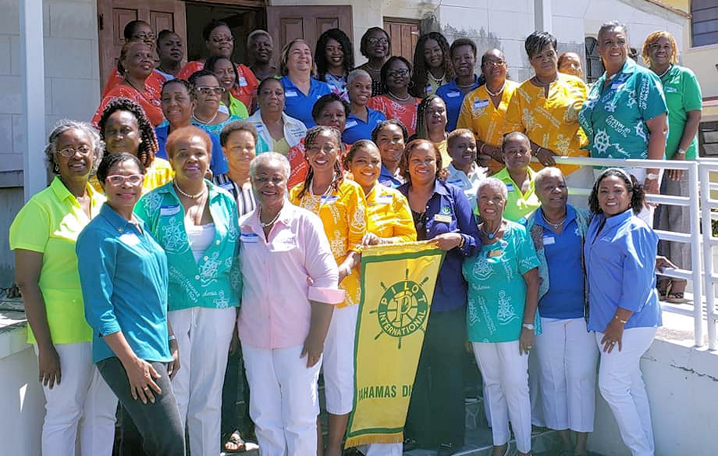
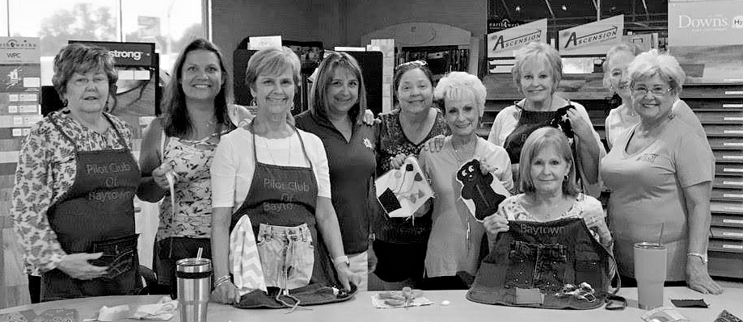
Pilot International Headquarters
102 Preston Court • Macon, Georgia • 31210
(478) 477-1208
www.pilotinternational.org
Instagram Twitter Facebook
YouTube LinkedIn Pinterest

Slide 13
Pilot International
Code of Ethics
Realizing that whatever a Pilot touches should be ennobled by that touch, we, as business leaders, are resolved to make our business standards high, to do our work in every place in which we are employed as if it were our life work, never omitting an opportunity of doing a kindness or making a friend; to put into our business dealings a note of sympathy for humanity; to follow truth; to do our best from dawn till night; and so to live in the discharge of our duty, so to take care of every responsibility that comes before us that we shall radiate that which is
unselfish, beautiful and true; and when we shall have finished with our tasks we shall have given an upward impetus to human ideals and achievements.
With this resolution before us then, we believe it is our duty as Pilots:
To consider our work worthy and ourselves worthy of our work, exemplifying in it at all times the Pilot motto,
"True Course Ever.“
To work each day at that which is before us seriously, vigorously, calmly, cheerily; to improve ourselves in every possible way; to increase our efficiency; to enlarge our visions.
To be ambitious to succeed, but always to be ethical, desiring nothing that is not achieved by justice, honesty and fairness.
To live in the presence of the great eternal laws, which will keep us patient when the task is irksome and calm and unspoiled when we seem to succeed.
To acquire self-control and self-reliance; to be ready to give as well as take; to develop in ourselves an appreciation of the finer things of life; to be honest and generous; to help, not to hinder; to be slow of criticism and quick with praise.
To cherish our visions and our ideals; to cherish the music that stirs our hearts, the beauty that forms in our minds, knowing that on these things we can build our world, for visions and dreams are the seedlings of reality.
To be loyal to Pilot in thought, word and deed.
To see no evil, hear no evil, speak no evil, think no evil of a Pilot, but to be no more loyal to a Pilot in this respect than we are to every other person, for the genius of Pilot is in its kindness, and justice is the soul and substance of life.
Pearl Sparks, Pilot Club of Florence, Alabama
The Code of Ethics was first presented in 1926 at the 5th Annual Convention held in Montgomery, Alabama with 69 Pilots attending.

