Slide 1

Questionnaire Results
Notes:
Come and join us for a Virtual walk-through Macon, Georgia. We will visit many sites which are special to Pilot International as well as sites that are special to the city of Macon Georgia. Join us on this walk to remember!!

Slide 2
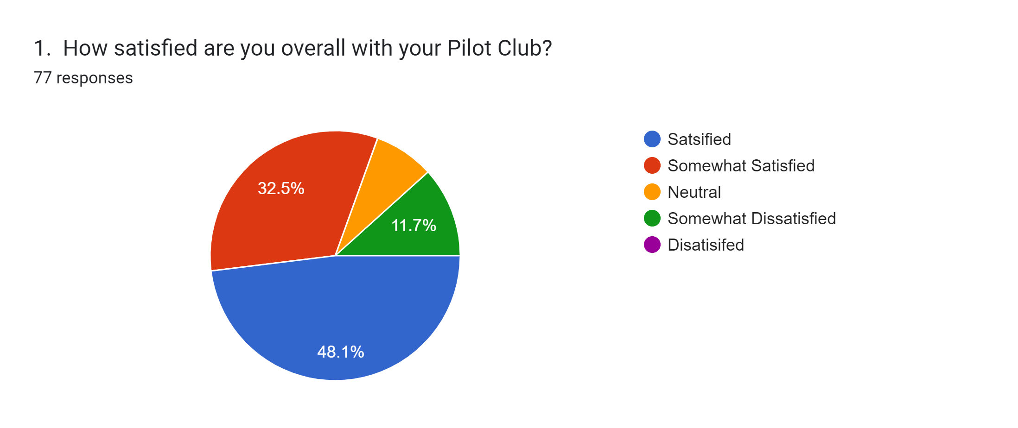

Slide 3
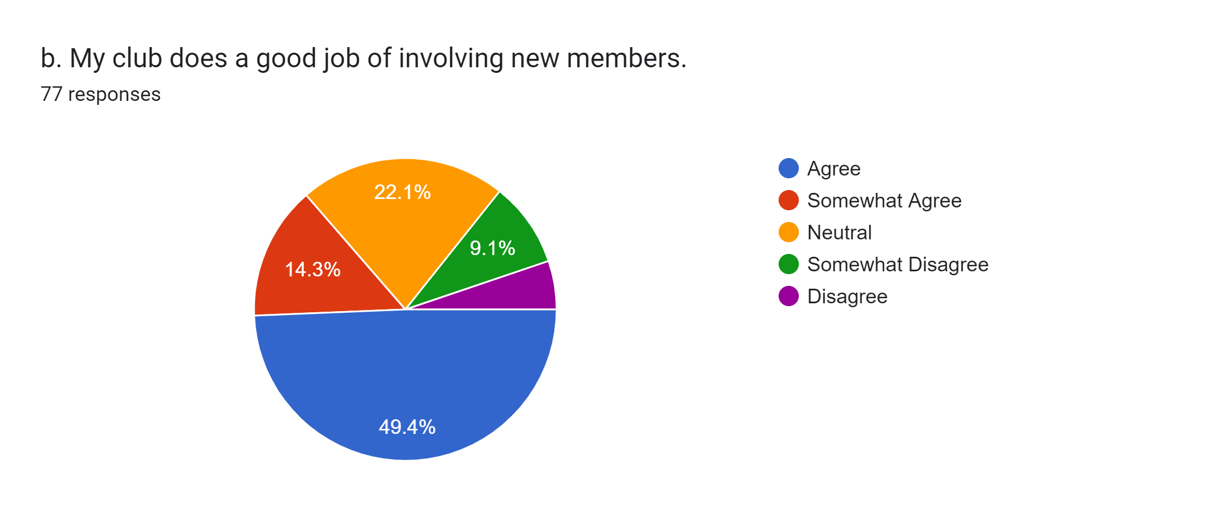

Slide 4
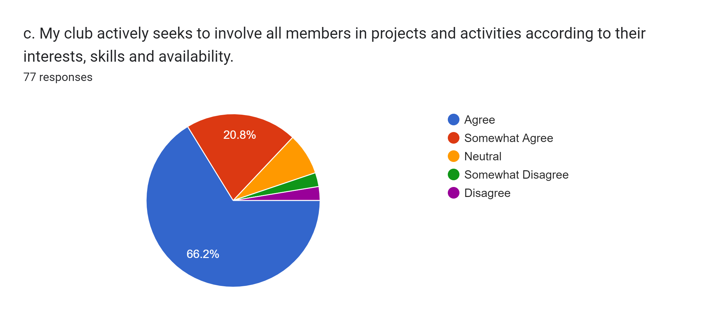

Slide 5
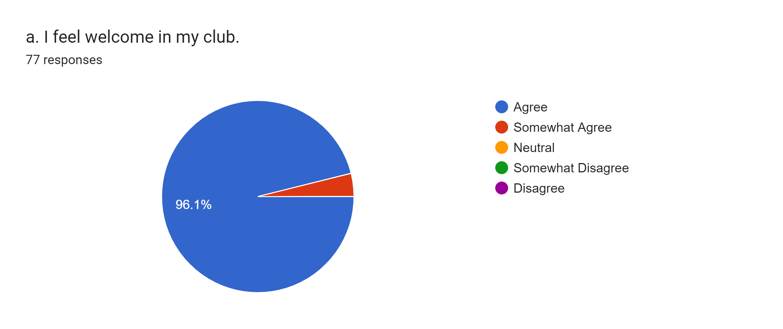

Slide 6
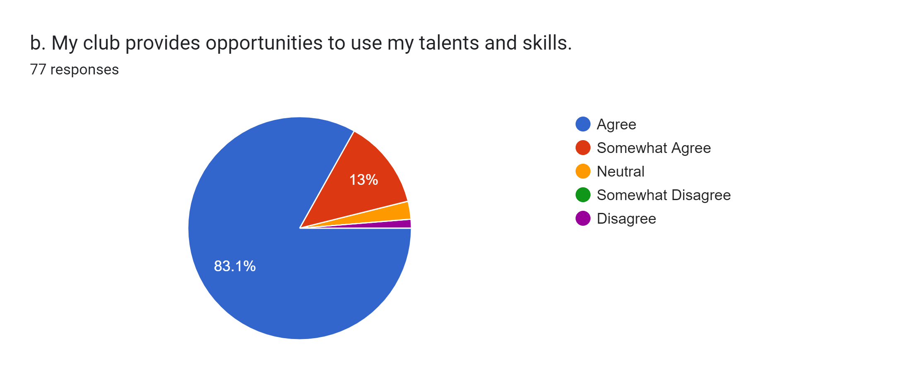

Slide 7
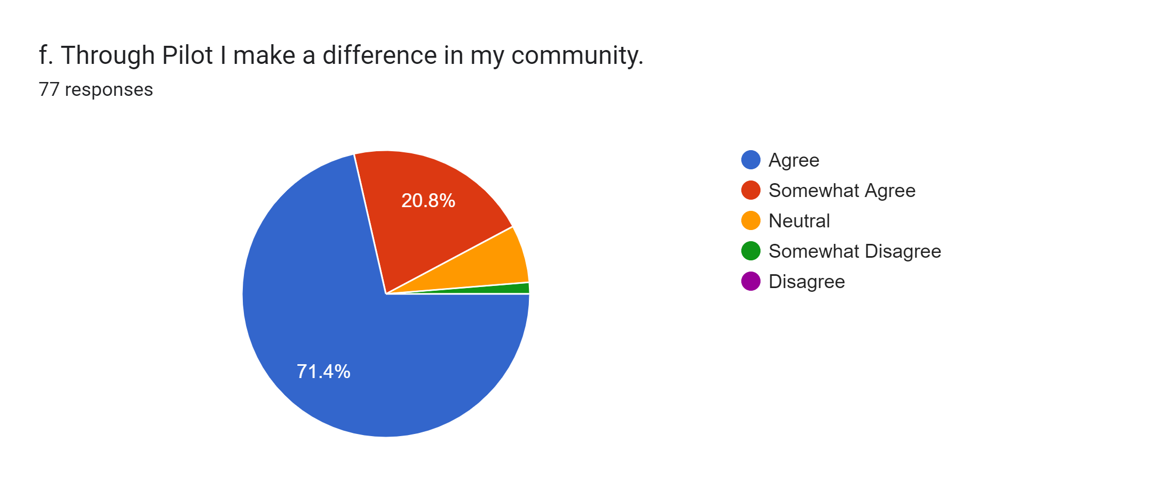

Slide 8
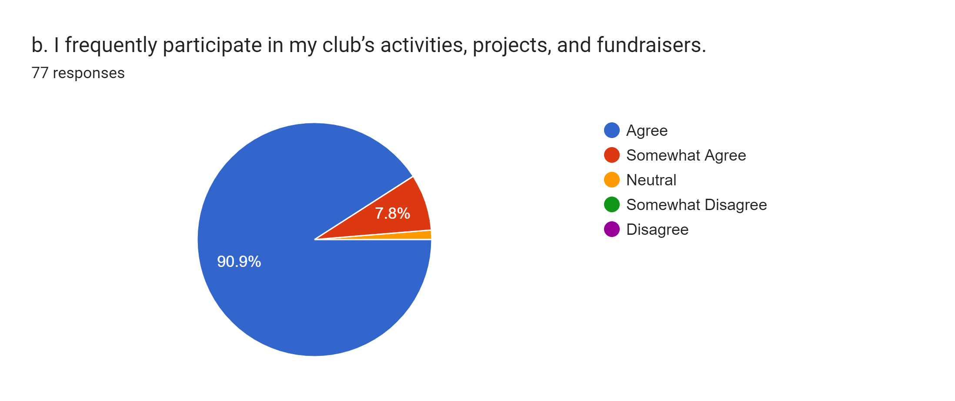

Slide 9


Slide 10
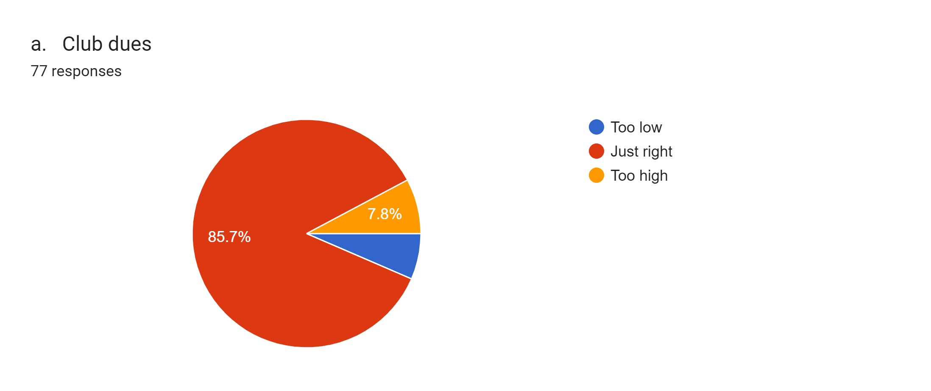

Slide 11
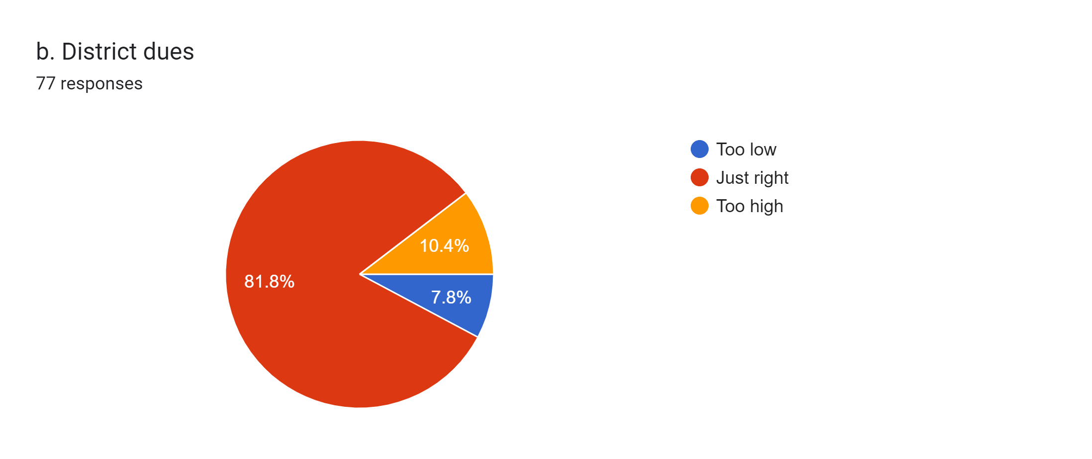

Slide 12
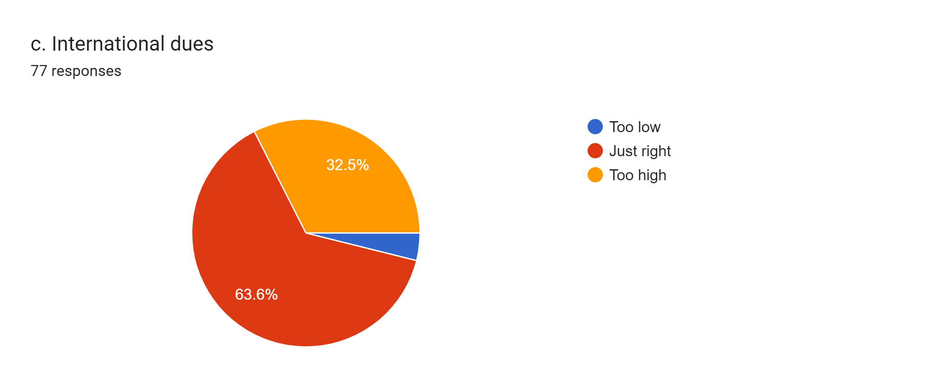
2020 – 2021 Executive Committee Board Members
Notes:
Our Executive Committee Board Members are from left to right:

Slide 13


Slide 14
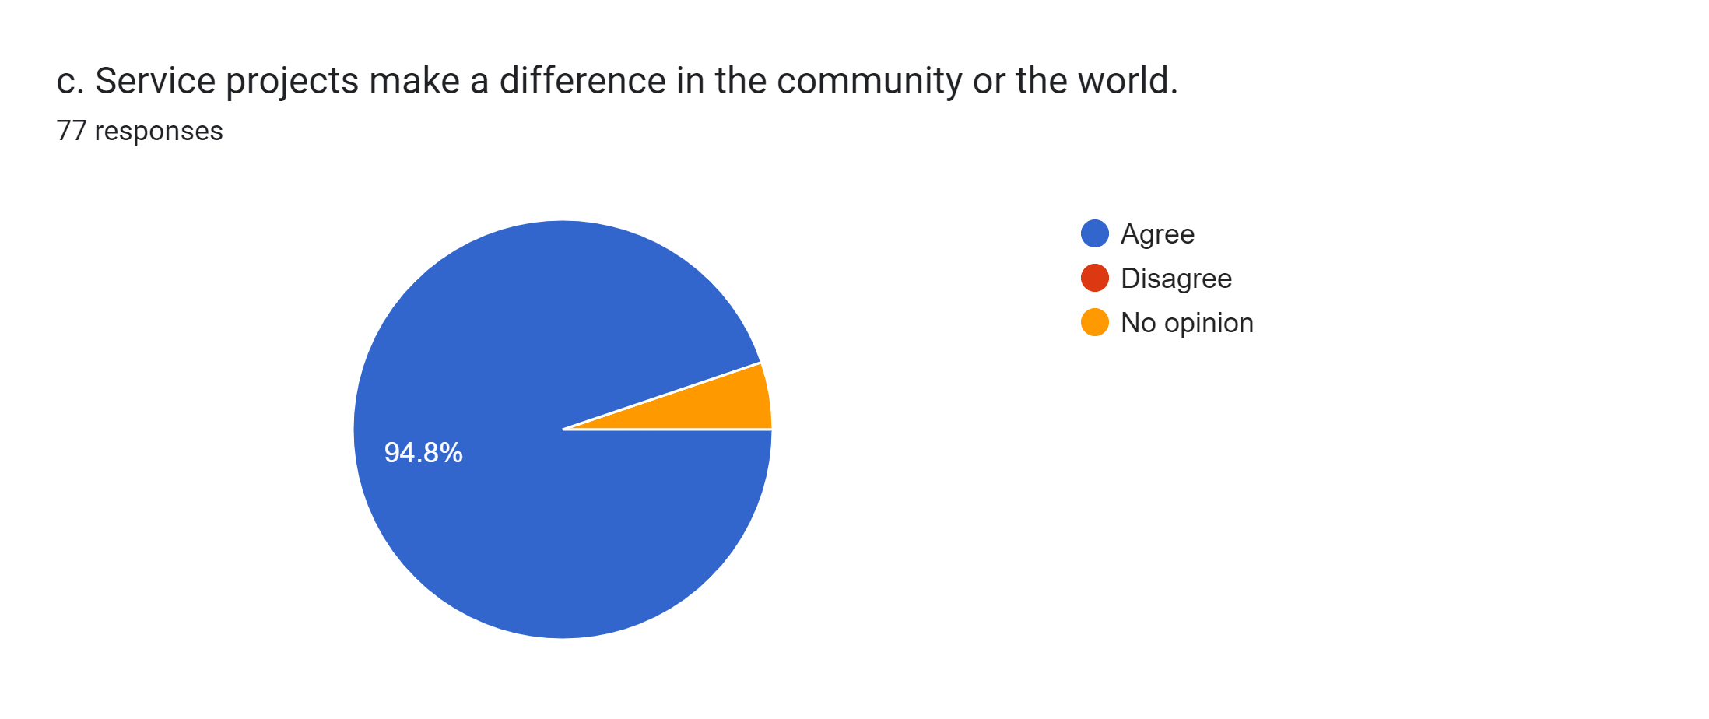

Slide 15
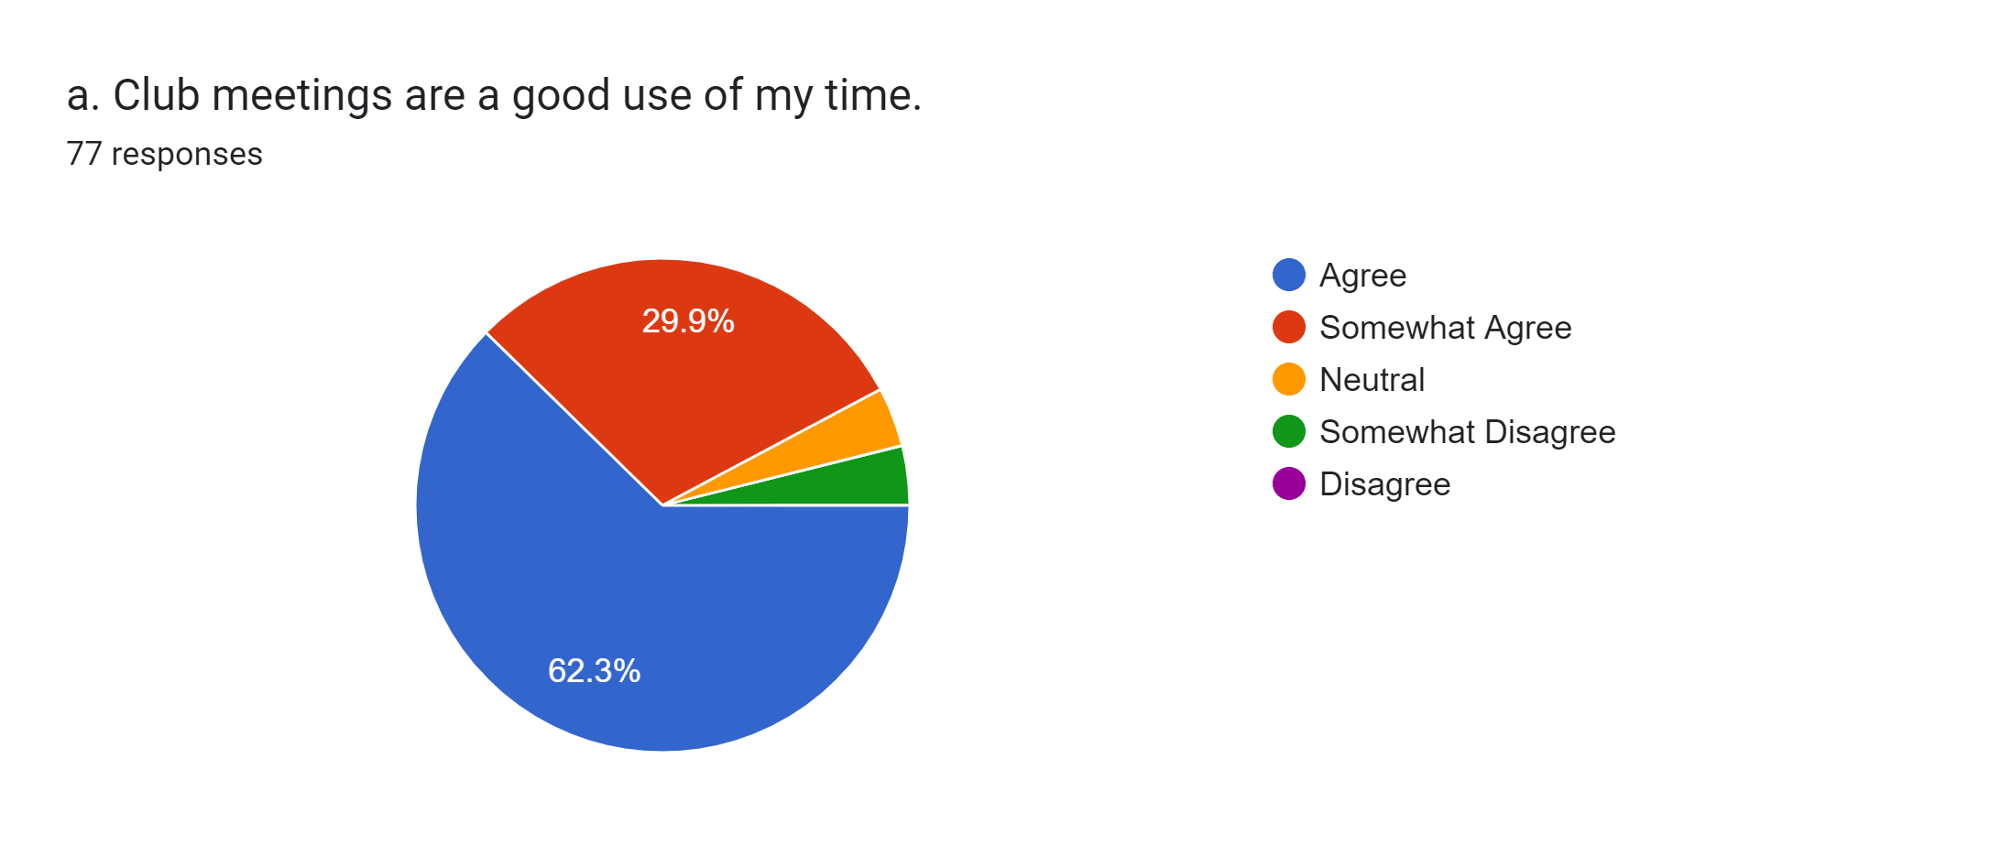

Slide 16
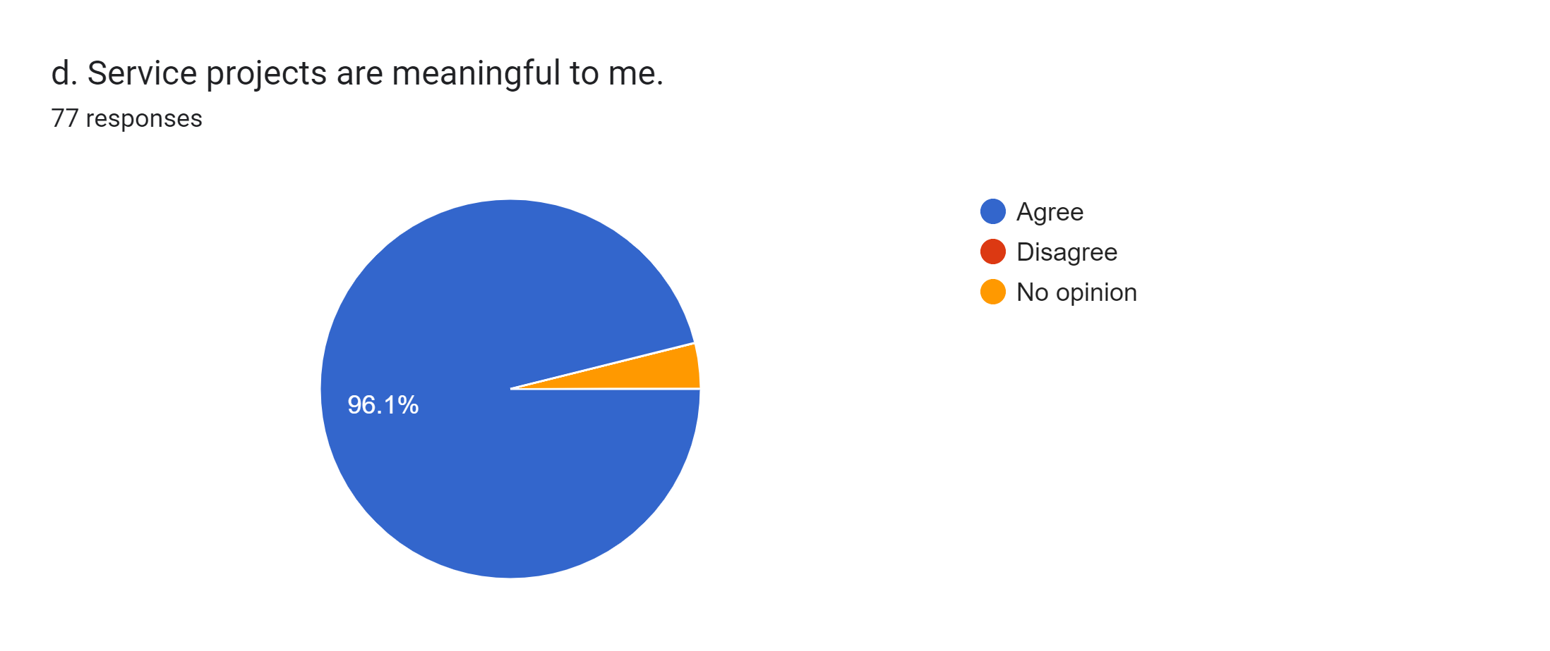

Slide 17

This Photo by Unknown Author is licensed under CC BY-NC

